Slide 1
Lecture 11 (Chapter 13)
Objectives
Formulate and solve mass transfer problems under unsteady state conditions considering the following situations:
Concentration does not change with position but changes with time (similar to the lumped model for heat transfer)
Concentration changes with time and position but the geometry is a simple slab
Mass transfer in a semi-infinite region so it occurs near the surface

Slide 2
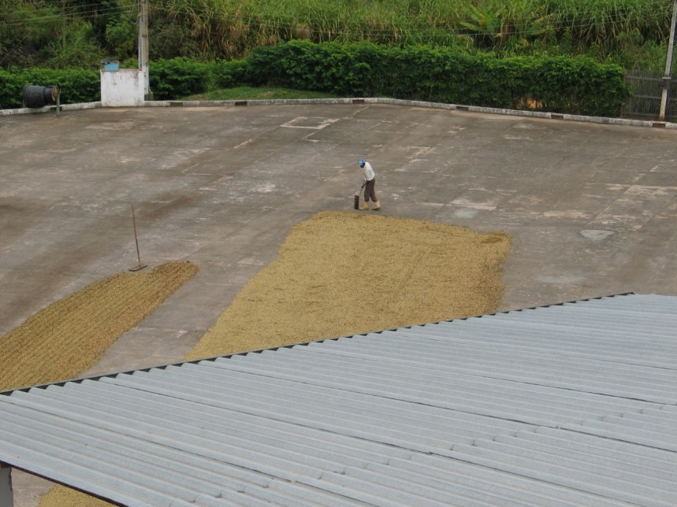
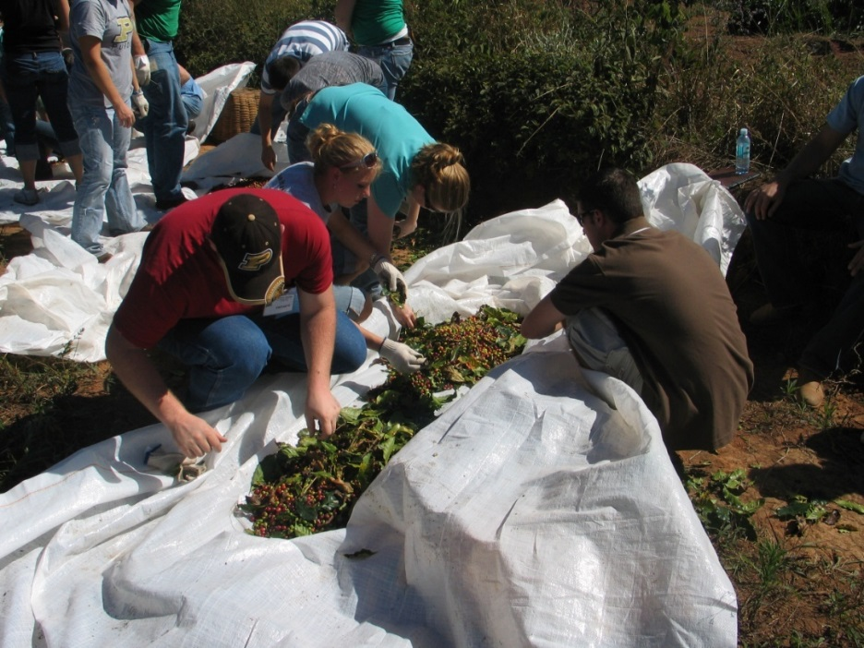
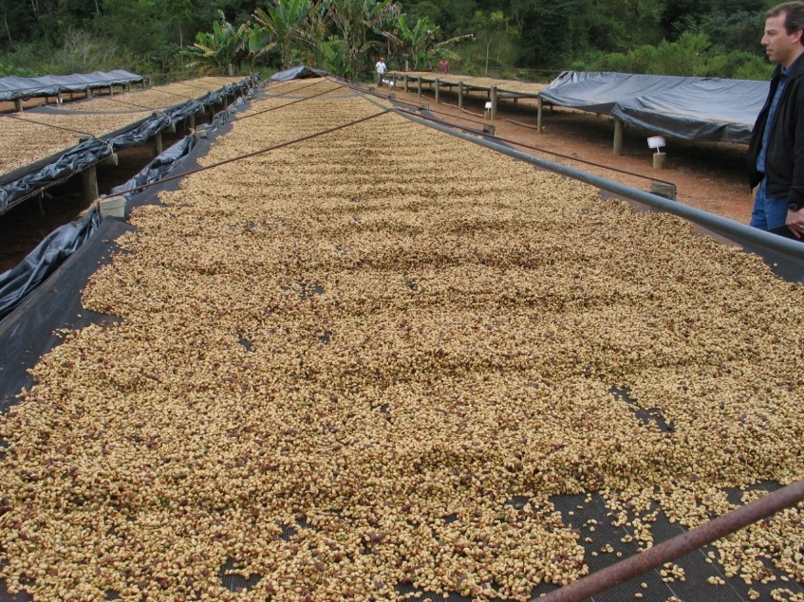
Drying Coffee

Slide 3
Transient Mass Transfer when Internal Diffusive
Resistance is Negligible. Lumped Parameter Analysis
e.g. in a Drying Process
The diffusing component
is water
Water diffusion
c_{w} (position, t)
Concentration of the
diffusing component
(water) In the fluid side
Internal Mass Transfer
“Internal Resistance”
External Mass Transfer
“External Resistance”
If the diffusion coefficient inside the solid is high → Internal Resistance to
mass transfer in the solid is negligible so the concentration gradient in the solid
is very small. Concentration is independent on position inside the solid, and
only is a function of time

Slide 4
Lumped Parameter Analysis
Internal Mass Transfer
“Internal Resistance”
External Mass Transfer
“External Resistance”
Mass Balance on the Solid (e.g. in a drying process)
m_{s} : mass of solid (dry)
w : weight fraction of diffusing component
(dry weight) like for
example water

Slide 5
Lumped Parameter Analysis
Drying Process
Case I – Solid surface has free water
Case II – Solid surface has no free water
Moisture in surface
“Moisture” isotherm
Moisture in air
Falling rate
time
time
constant
rate
time

Slide 6
When the Lumped Parameter Approach
is valid?
Heat Transfer
Mass Transfer
Conduction
Diffusion
Biot Number
Convection
Convective mass transfer
Use Lumped parameter
analysis
Use Lumped parameter
analysis
Do not use lumped
parameter analysis
Do not use lumped
parameter analysis

Slide 7
The Biot Number – Mass Transfer
or

Slide 8
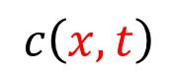
Unsteady State (transient) diffusion when
internal resistance is not negligible
=0
=0
$$c\left(x,t\right)$$
Storage of A
Generation
(e.g. chemical
reaction)
Convection
Diffusion
concentration
in the solid

Slide 9
Unsteady State (transient) diffusion when
internal resistance is not negligible
For Heat Transfer
Fourier Number
Thermal
diffusivity

Slide 10
Unsteady State (transient) diffusion when
internal resistance is not negligible
for long times, exponents with n >0 become negligible

Slide 11
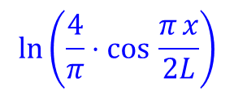
Unsteady State (transient) diffusion when
internal resistance is not negligible
Long Times
$$ln\left(\frac{4}{π}⋅cos\text{ ​}\frac{π x}{2L}\right)$$
Intercept =
Changes with time t
In one fixed position
In this case one value of x

Slide 12
Spatial Average
Time, t

Slide 13
Concentration Changes with Size
for a given system (D and concentration profile (i.e. c_{avg} (t))known)
half thickness (slab)
Radius (cylinder)
Radius (sphere)

Slide 14
UNSTEADY MASS TRANSFER
Internal and external mass transfer are present
Heat Transfer
Mass Transfer

Slide 15
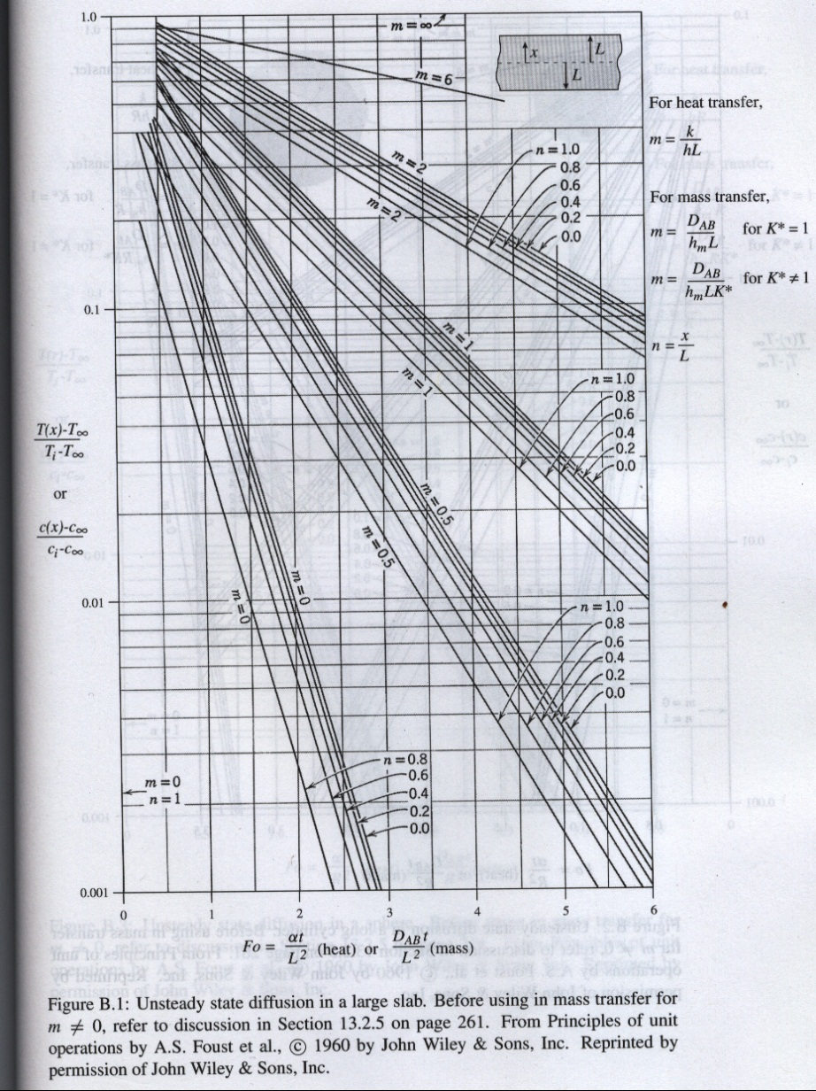
Unsteady State (transient) diffusion when
internal resistance is not negligible
SLAB

Slide 16
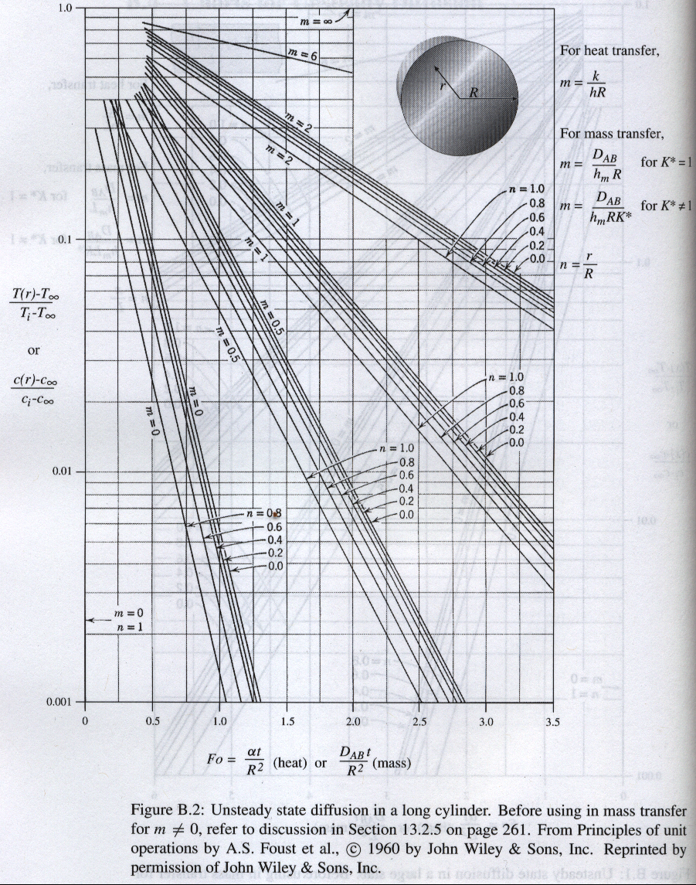
Unsteady State (transient) diffusion when
internal resistance is not negligible
CYLINDER

Slide 17
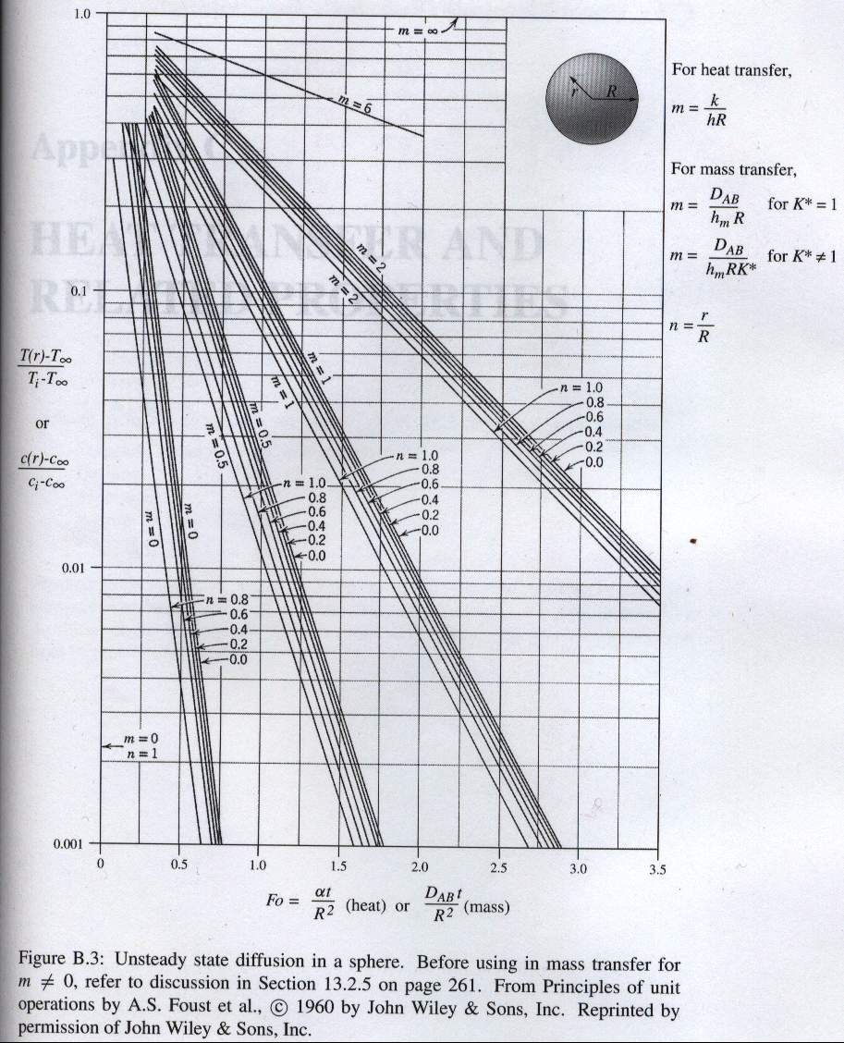
Unsteady State (transient) diffusion when
internal resistance is not negligible
SPHERE

Slide 18
Transient Diffusion in a semi-infinite region
Concentration in the surface c_{s}
x=0
Initially the temperature of the semi-infinite
solid is c_{i} and suddenly one of the face of the solid is exposed to a concentration c_{s}
=0
=0
x
Concentration is c_{i}

Slide 19
Transient Diffusion in a semi-infinite region
Diffusive mass flow
Minimum thickness
time

Slide 20
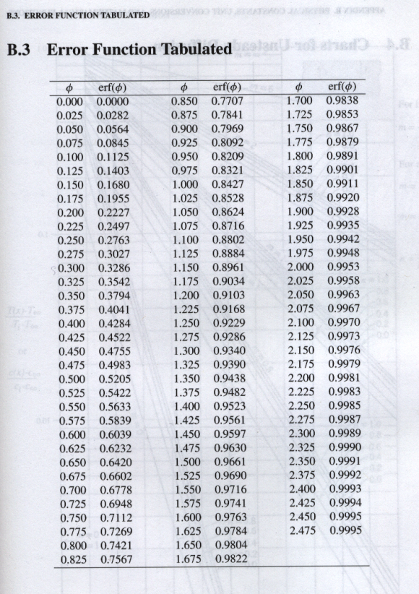
Error Function
Transient Diffusion in a semi-infinite
Region - solution
and
That is, for
x can be considered infinite

